Slide 1


Robotic Arm for Surveillance
Project Team
Mayank Lakhani 1NT16EC076
Md. Ayub Modi 1NT16EC082
Nikhil Kumar G 1NT16EC092
Saicharan T. 1NT16EC131
Under the Guidance of
Ms. Shylaja S
Assistant professor,
Department of E&CE

Slide 2
Contents
Problem statement
Literature survey
Abstract
Objective
Introduction
Description of the project
Block Diagram
Flow Chart
Methodology
Results
Conclusion
Scope for improvement
References

Slide 3
Problem Statement
Developing surveillance and monitoring systems can be quite challenging at times.
Monitoring areas like border, defence areas is a great challenge for the soldiers or security officers, as they will need to spend too much time patrol covering all places.
To overcome this situation we develop a robotic arm for surveillance for monitoring such areas.

Slide 4
Literature survey
Author | Title | Outcome | Remark
M. Meena 1, P. Thilagavathi (2013) | Automatic Docking System with Recharging & Battery replacement for Surveillance Robot | The development of automatic docking system where the robot can return to docking station for recharging operations when the battery is low. | There are two units to check whether the robot enters to docking station, one is I sensor and other is electrode unit on the oscillating bar. It only takes 30 seconds to accomplish the battery exchanging process.
K.Aruna, A.SriRamsagar, G.Venkateswarlu(2013) | Mobile Operated Overhead Crane | Robot is controlled by a mobile phone that makes a call to the mobile phone attached to the robot. In this call if any key is pressed corresponding tone is heard at the other end of the call by using dual tone multiple frequency (DTMF) | The primary function of the mobile operated robot with DTMF decoder is to move that places where man can’t move. The robot perceives the DTMF tone with the help of phone stack in the robot
Dr. Shantanu K. Dixit, Mr. S. B. Dhayagonde (2014) | Design & Implementation of e-surveillance Robot for Video Monitoring & Living body detection | This study helps us to detect living bodies with the help of PIR sensor and to control the robot with the help of internet. The camera mounted robot is able to move horizontally and vertically. PIC 16F877 is used for controlling dc motors. | This technology gives helping hand to our security forces for detecting intruders. Also, used in finding the injured persons during disasters such as earthquakes, collapsing of buildings, in mining fields and can be used as a spy robot. PIR sensor for detecting living being

Slide 5
Abstract
To develop a system for the continuous surveillance.
To monitor remote areas with the Tele robotic mechanism.
To visualize live situation on defense area like border, LOC, etc.
Our project aims to make the best use of technology to overcome human force on such areas as mentioned.
Our project consists of IOT based vehicle , webcam and a robotic arm mounted on it for to hold the camera which can move 90 degree.
Board used – Raspberry pi 4 (CPU: quad core 64-bit arm cortex A53 clocked at 1.2GHz)
Programming language – python
Arduino Nano is used to control the robotic vehicle and web camera movement

Slide 6
Objective
The main objective of the project is to monitor any unauthorized entry of a person or suspicious activity.
Mainly used for defence purpose.

Slide 7
Introduction
Robotics is one of the important fields in the concern of defense purpose, industrial usage, medical field, etc.
Advancement areas in the technology to lead robotics as embedded to the field of service, security and safety.
In our project we have used the following;
>Raspberry Pi
> Arduino Nano
> DC motor
> Servo motor
> Ultrasonic sensor
> Web server (Firebase) which is setup on the Raspberry Pi 4 to monitor remotely
> Web camera to take pictures

Slide 8
Description of the project
This project aims to monitor and do surveillance of restricted area from unauthorized entry of person or illegal activities.
Aims to detect the person.
Aims to send the information to the control room.
Alerts the security head take action or the robot can initiate the action

Slide 9
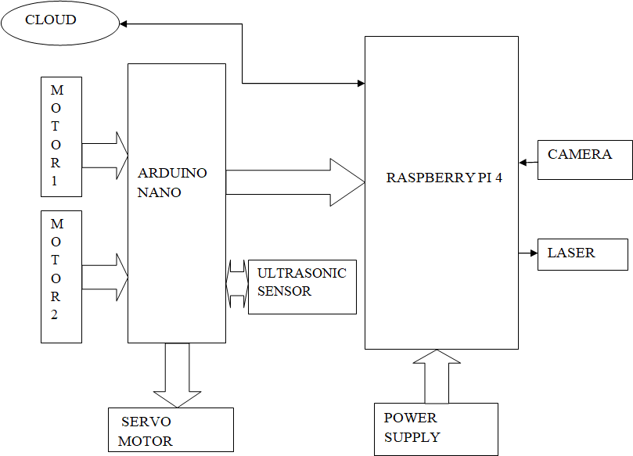
Block Diagram

Slide 10
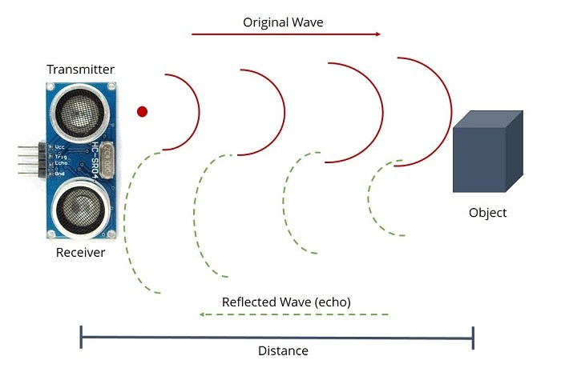
Flowchart
Pattern of Obstacle avoidance by ultrasonic sensor

Slide 11
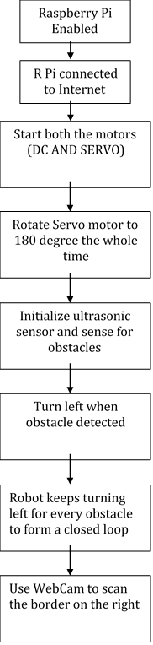
Flowchart of dc motor and servo motor

Slide 12
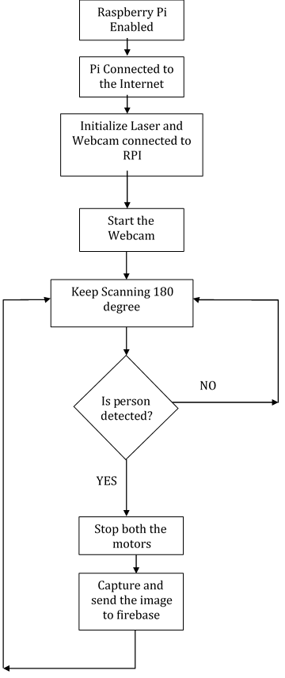
Flowchart of Webcam

Slide 13
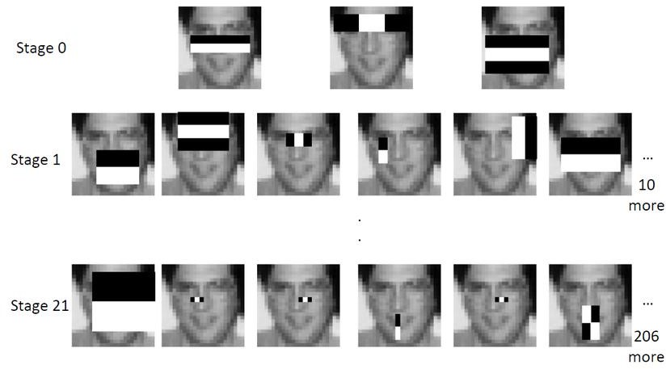
Stages explaining how the Webcam detects a person by collecting a number of positive and negative images using Haar Cascade classifier.

Slide 14
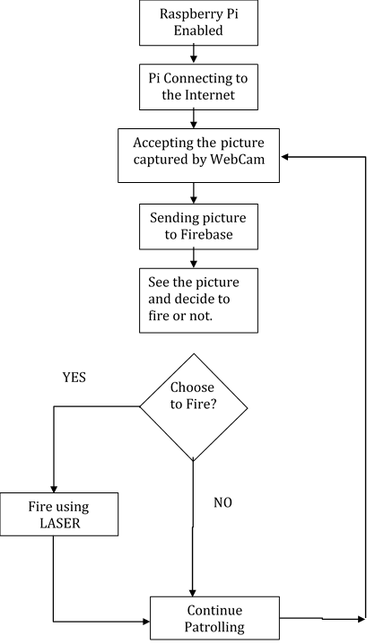
To understand how firebase is interacting with the robot.

Slide 15
Methodology
Initially the Raspberry Pi is enabled, it connects to the internet first.
The main components of the project are initialized i.e. the webcam and laser
The webcam is mounted on the servo motor which covers an area of 180° continuously.
The Webcam keeps scanning the area to detect any person on the right side of the robot, while the robot is patrolling around a plot of land, securing it by continuously taking left turns and forming a closed loop around it.
Upon the Webcam, resides the LASER which is used to fire when we command it.
If the Webcam detects any person trying to trespass, the robot stops right there, i.e., both the motors stop and a picture is captured which is sent to the firebase.
Based on the command received either the LASER shoots the suspect or ignore it and the robot continues its motion and keeps scanning.

Slide 16
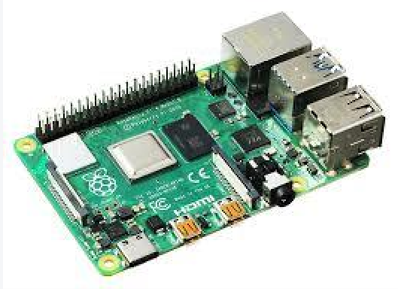
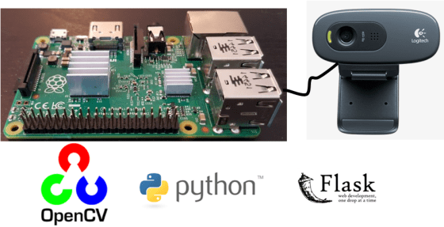
Hardware and Software tools
Hardware tools:
Raspberry Pi
> 1GB, 2GB or 4GB LPDDR4-3200 SDRAM (depending on model)
> 2.4 GHz and 5.0 GHz IEEE 802.11ac wireless, Bluetooth 5.0, BLE
> Gigabit Ethernet
> 2 USB 3.0 ports; 2 USB 2.0 ports.
> Raspberry Pi standard 40 pin GPIO header
Webcam
> Resolution and Frame Rate 720p upto 30fps.
> Sensor Resolution – 3MP

Slide 17
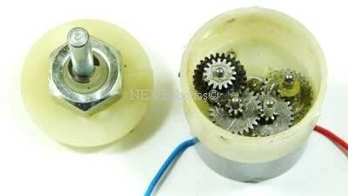
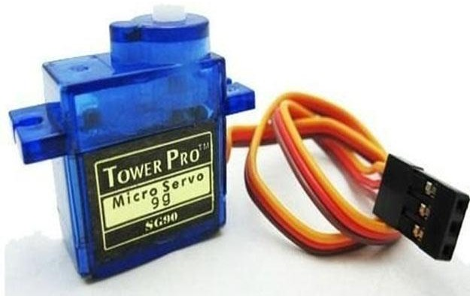
DC gear motor
> DC supply: 4 to 12V
> RPM: 10 at 12V
> Total length: 46mm
> Motor diameter: 36mm
Servo motor
> high RPM
> DC supply: 4 to 12V
> low torque

Slide 18
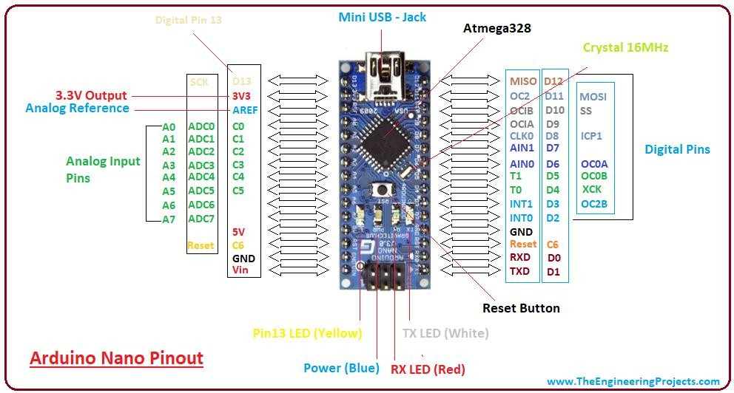
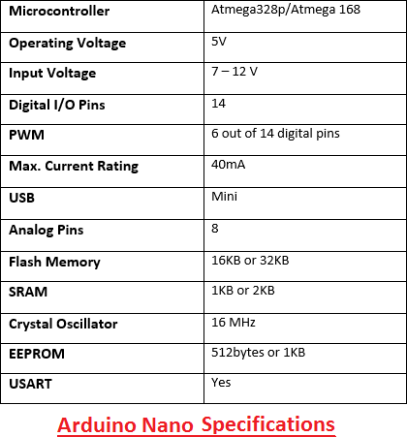
Arduino Nano

Slide 19
Software Tools:
OpenCV - A library of programming capacities for the most part gone for ongoing pc vision
Python - a broadly utilized abnormal state programming dialect for universally useful programming.
Firebase - Firebase is a mobile and web application development platform developed by Firebase, Inc. in 2011
Google Analytics
Firebase Cloud Messaging
Firebase Authentication
Firebase Realtime Database
Cloud Firestore
Firebase Storage
Firebase Hosting
ML Kit

Slide 20
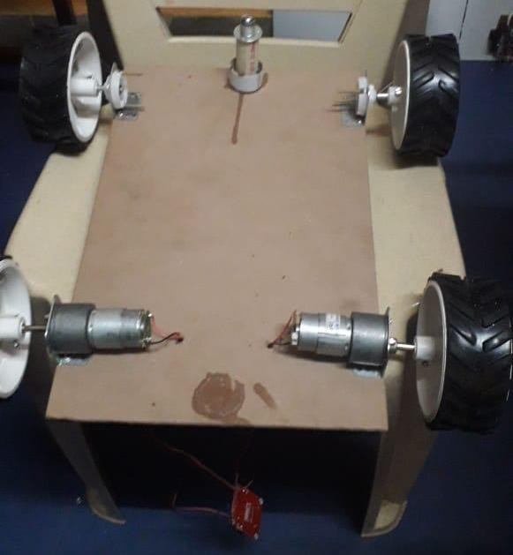
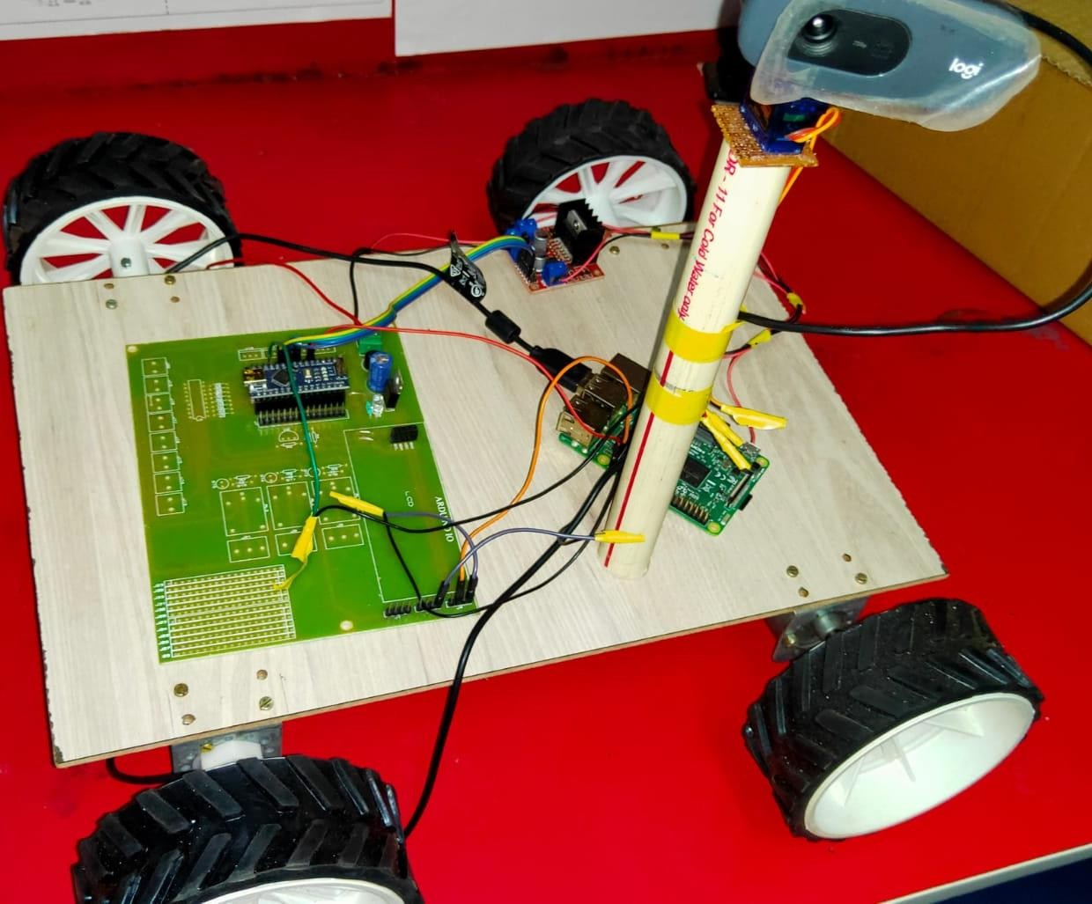
Result
The DC Motor is connected to robot in order to generate linear motion
Webcam is Mounted on servo motor as shown in the figure

Slide 21
Conclusion
This project describes an automatic controlled robotic and robotic arm from webpage with continuous surveillance of actions done by the tele robotic arm.
Mobile robot connected through wireless dongle or Wi-Fi and the telerobotic can be visualize the acknowledgement with continuous response from remote end with monitoring via webpage.
In this project we used raspberry pi working on Raspbian OS.
One can easily monitor as well as control the activity of the robotic unit.

Slide 22
Scope for Improvement
By making this project with extension of GPS to navigate based on the locations given through the network.
we can move tele robot to the multipurpose actions among remote surveillance.
use different types of sensor so that we can use robot in different field i.e. Temperature Sensor, Pressure Sensor, Heat Sensor, Position Sensor, Proximity Sensor

Slide 23
References
Heng-Tze Cheng, Zheng Sun, Pei Zhang, “Real-Time Imitative Robotic Arm Control for Home Robot Applications”, Carnegie Mellon
University, ” IEEE transactions on cybernetics., vol. 21, no. 6, pp. 1057-7149, March 2011.
V. Ramya, B. Palaniappan, T. Akilan “Embedded System for Robotic Arm Movement Control using Web Server and ZigBee Communication”,
International Conference on Research Trends in Computer.
Technologies, Proceedings published in “International Journal of Computer Applications”, (IJCA) (0975 – 8887), pg 30-34, 2013. S.HemanthKumar, B.AnandaVenkatesan “Teleoperation Of Robotic Arm With Visual Feedback”, International Journal of Advance Research In Science And Engineeringhttp,IJARSE, Vol. No.4, Issue 03, March 2015 ISSN-2319-8354(E).
ttp://electronicsforu.com/newelectronics/articles/raspberry.asp
Technology and Advanced Engineering (ISSN 2250-2459).

